Slide 1
Software Project Management
Controlling Process Group
Closing Process Group

Slide 2
Tracking Project Performance
You need to have system for measuring and quantifying the performance of your project; so that you can be sure, that you’re moving in the right direction.

Slide 3
Tracking Project Performance
You not only need to track the project performance but also communicate it to stakeholders.
You will need to prove it to stakeholders that everything is as it should be with your project.

Slide 4
Project Metrics
Your project metrics are the processes, tools, and techniques that you use to measure the progress of your software project.

Slide 5
Project Metrics
Project metrics enable you to proactively recognize whether
You’re on track with your software project
You’re ahead of or behind schedule
You’re under or over budget
You’re performing to the quality standards defined by your organization
Your project team members are performing to their maximum ability
The potential risks you’ve identified have materialized and could potentially adversely affect the project
You need to intervene to bring the project back on track

Slide 6
Project Metrics
Earned Value Management
Benchmarking
Project Audits
Procurement Metrics
Pareto Charts
Control Charts

Slide 7
Benchmarking
This process compares your current project activities to those performed in other similar projects.
For Example:
User Interface similar to Microsoft Office
Less Complex than Twitter Mobile App;
Better Compression than JPEG

Slide 8
Project Audits
Audits (Quality Assurance) are used to determine whether particular project processes conform to defined parameters.
Audit are formal reviews of what’s been completed within a project, what worked and what didn’t work.
The end result of the audit is to improve performance of the current project (or other projects or the entire organization)
Quality improvement requires action to improve the project effectiveness.

Slide 9
Procurement Metrics
Metrics that are used to evaluate (monitor) contractors and vendors:
Contract Change Control System
Describe processes needed to make contract changes
EVM
Audits

Slide 10
Pareto Charts
Pareto chart is a graph that ranks the most common causes for the most common problems
It is a quality control tool
Logic: Small number (20%) of causes create a large number (80%) of issues

Slide 11
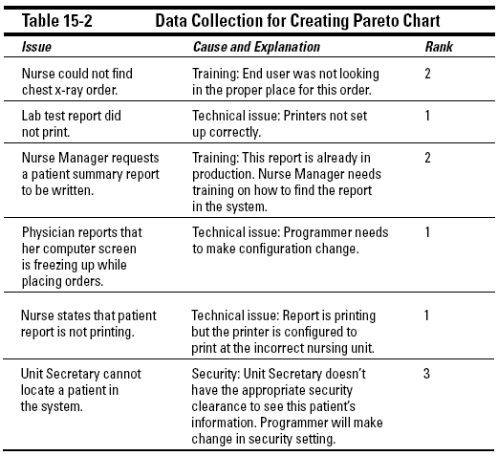
Pareto Charts

Slide 12
Some typical causes of problems in a software project include
Inadequate software testing
Vendor noncompliance
Improper end-user training
Lack of defined scope
User error
Technical issues
Technology becoming obsolete

Slide 13
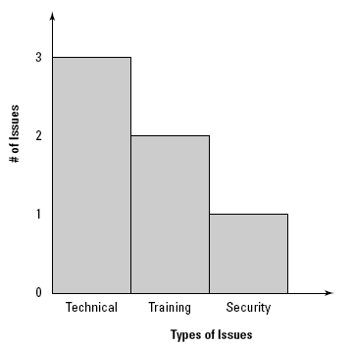
Pareto Charts

Slide 14
Control Charts
Charts that show processes that are not reliable or stable.
It is a quality control tool

Slide 15
Control Charts
The control chart contains three horizontal lines:
One line represents the acceptable upper limit.
One line represents the acceptable lower limit.
One line, in the middle, represents the mean.

Slide 16
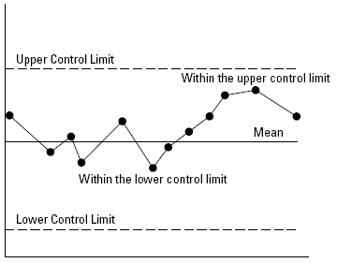
Control Charts
The data points that you plot outside of the upper and lower limits represent issues that may be the result of special causes. After you identify a special cause, you can attempt to eliminate it so that it doesn’t result in future errors.
For Example: Number of hours spent by team members

Slide 17
Tracking Project Performance
Be Proactive
Find Problems Before they Find You

Slide 18
Closing Process Group
You need to tie up all loose ends and bring all activities to a clear, crisp end.
Scope Validation
Quality Control
Closing Out Vendor Contracts
Releasing Software Project Team
Lessons Learned Document

Slide 19
Scope Validation
Ensure that the appropriate stakeholders are satisfied with the final product
Validation is concerned with checking that the system will meet the customer’s actual needs.
When the stakeholders formally accept the completed project scope and all of the resulting deliverables, they are validating the project scope.
You should always get something formal in writing from the clients stating that they are satisfied with the final deliverables of the software project.

Slide 20
Quality Control
Making sure that your product is up to the quality standards that your client has set forth for this project.
Create a quality checklist to ensure that you and your team members have performed all of the required steps required to adhere to your set quality standards. (Product & Project)

Slide 21
Closing Out Vendor Contracts
You should perform an audit to verify that vendor's work meets all the documented requirements (Quality & Scope) of the software project.
Making Payment – Use your payment system (Usually your accounts department will take care of this)

Slide 22
Releasing Project Team
Make sure every team member knows from start when they will be released
You will need to write employee evaluations
Ask the team to evaluate your performance
Remember, even if some of your team members make negative comments, that’s still positive if you learn from these comments.

Slide 23
Lessons Learned Document
Lessons Learned Document allows you to pass on information to other project managers and to maintain records for yourself.
The input to any project should be the lessons learned document from previous projects. The output from any project should be the lessons learned document for future projects.
You should always start your lessons learned document at the beginning of your project to ensure you capture lessons learned right from the start.

Slide 24
Lessons Learned Document
Whenever you start a new project, you should always seek out all existing lessons learned documents from similar projects that have come before and use them to help prepare for your upcoming venture.
When you write your own lessons learned document, you should bear in mind that others will be reading this document in the future, so you should write to that audience.

Slide 25
Lessons Learned Document
A summary or foreword section
Lessons Learned
Acknowledgments, references, and resources

Slide 26
Lessons Learned Document
Summary or Foreword Section
Example: The XYZ project was a project in which we built a Web-based program that allowed the residents of ABC to pay traffic tickets online. Originally expected to last six months, the project lasted roughly eight months, between January 2 and August 15, 2010.
The foreword should not be more than one page and may include a specific list of functions the software was originally contracted to include.

Slide 27
Lessons Learned Document
Lesson Learned
At the very beginning of your project, create a spreadsheet to document mistakes and successes.
Share it with your team and make documenting lessons learned a regular agenda item for your team meetings, asking the question, “What did we learn from this?”
Organize it by stakeholders
Developers
Project Manager
Users
Others
You may also offer advice for future project managers

Slide 28
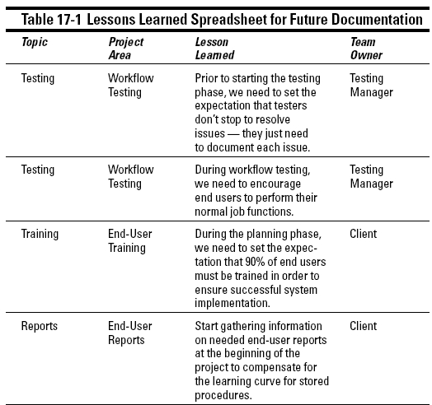
Lessons Learned Document

Slide 29
Software Project Management
Process Groups
Knowledge Areas
Initiating
Planning
Executing
Controlling
Closing
Scope Management
Time Management
Cost Management
Quality Management
Human Resources Management
Communications Management
Risk Management
Procurement Management
Integration Management
Stakeholder Management

Slide 30
Q & A

